Slide 1

2024
LASNIER - LAZREG – POILVE
Applied System Software

Slide 2
Agenda

Slide 3

Presentation of Project
Connect 4 video game coded in python with a simple interface, accompanied by instructions for using the computer program.
For simplicity purposes we chose to use a basic library (Tkinter)

Slide 4
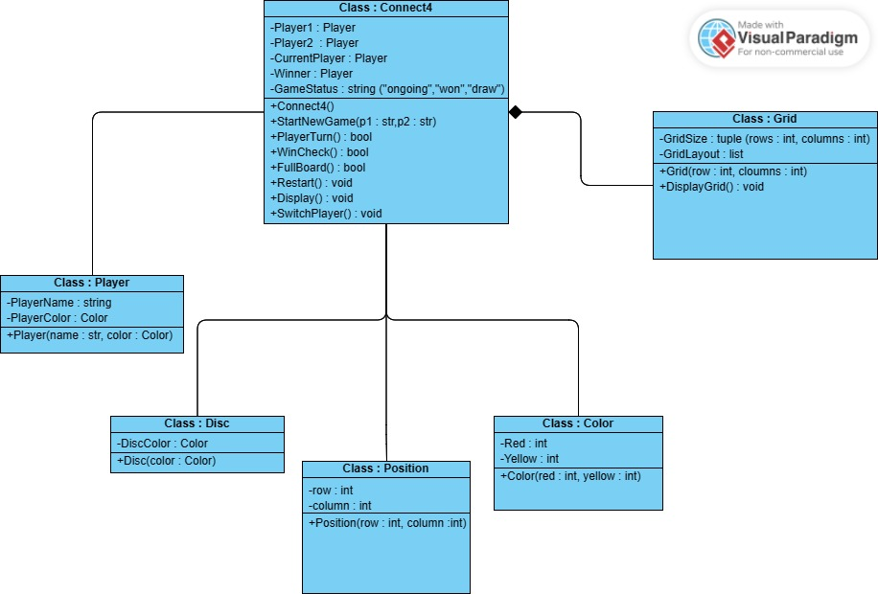
Software Design
UML class diagram

Slide 5
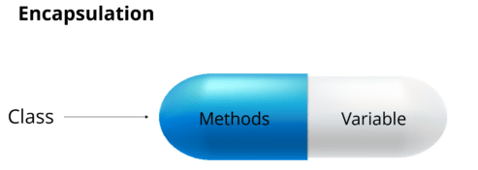

Implementation
Programming concepts used :
user input/output
Object Oriented Programming
Conditional statements
Composition (to represent relationship between our classes)
Event handling (to spawn a coin when the player clicks)
Encapsulation
+ Documentation (ReadMe)

Slide 6
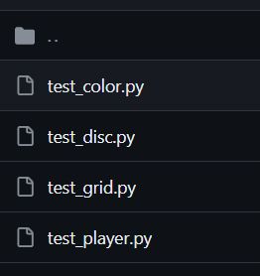
Tests of the game
4 files

Slide 7
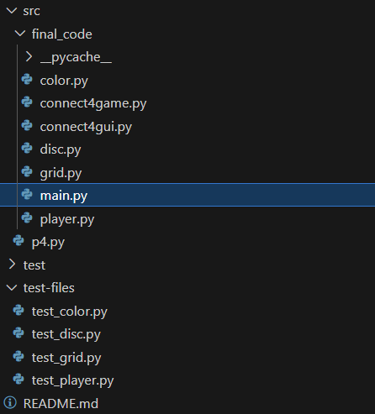
Demo of Alpha and Release version
Code arborescence

Slide 8
Repartition (7 à 10min)
Mehdi :
Aurélien :
Alexandre :

